Slide 1
Priority Queues
Presentation for use with the textbook Data Structures and Algorithms in Java, 6th edition, by M. T. Goodrich, R. Tamassia, and M. H. Goldwasser, Wiley, 2014

Slide 2
Trees Review
Hierarchical data structure that consists of nodes with a parent-child relation
Root: node without parent (A)
Internal node: node with at least one child (A, B, C, F)
External node (a.k.a. leaf ): node without children (E, I, J, K, G, H, D)
Ancestors of a node: parent, grandparent, grand-grandparent, etc.
Depth of a node: number of ancestors
Height of a tree: maximum depth of any node (3)
Descendant of a node: child, grandchild, grand-grandchild, etc.
Subtree: tree consisting of a node and its descendants
A tree is ordered if there is a meaningful linear order among the children of each node
Tree ADT
We use positions to abstract nodes
Tree interface for trees where nodes can have any number of children
parent
children
numCHildren

Slide 3
Trees Review
isInternal
isExternal
isRoot
isEmpty
Iterator
position
AbstractTree Base Class implements:
isInternal
isExternal
isRoot
isEmpty
Tree Traversal
a preorder traversal of a tree T, the root of T is visited first and then the subtrees rooted at its children are traversed recursively
postorder traversal of a tree it recursively traverses the subtrees rooted at the children of the root first, and then visits the root

Slide 4
Trees Review
Binary Trees
Each internal node has at most two children (exactly two for proper binary trees)
The children of a node are an ordered pair
We call the children of an internal node left child and right child
Applications
arithmetic expressions
decision processes
searching
BinaryTree ADT
BinaryTree interface extends the Tree interface and adds three methods:
position left(p)
position right(p)
position sibling(p)
AbstractBinaryTree Base Class extends AbstractTree and implement BinaryTree
Implements:
sibling
numChildren
children

Slide 5
Trees Review
Binary Trees
inorder traversal a node is visited after its left subtree and before its right subtree
Implementing Trees
Using a linked structure
A node is represented by an object storing
Element
Parent node
Sequence of children nodes
Node objects implements the Position ADT
Linked Structure for Binary Trees
A node is represented by an object storing
Element
Parent node
Left child node
Right child node
Node objects implements the Position ADT
LinkedBinaryTree class
Inner Node class
Two instance variables: root and size
Updating operations

Slide 6
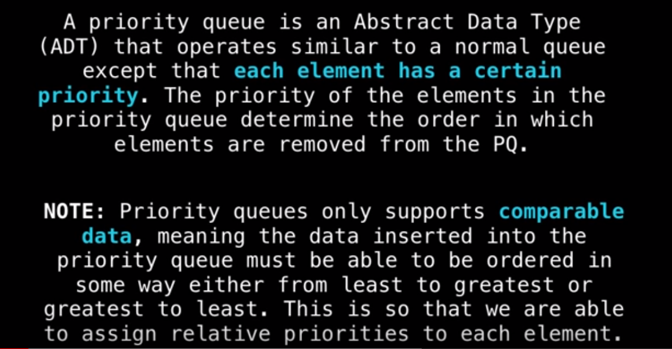
What is Priority Queues?
Notes:
https://www.youtube.com/watch?v=wptevk0bshY
https://www.youtube.com/watch?v=QOJ-CmQiXko
https://www.youtube.com/watch?v=HCEr35qpawQ

Slide 7
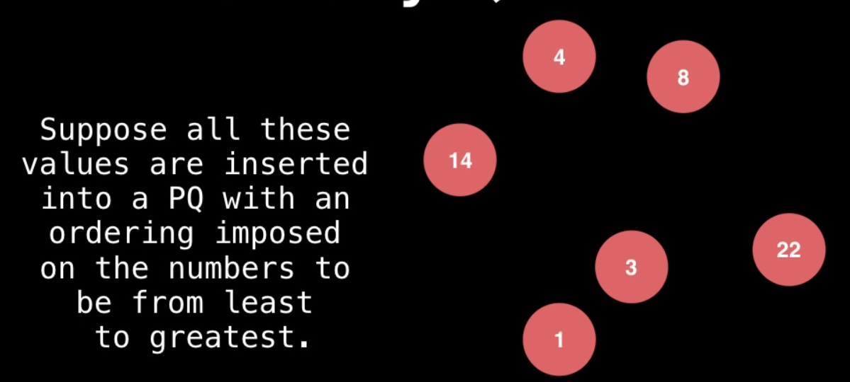
What is Priority Queues?

Slide 8
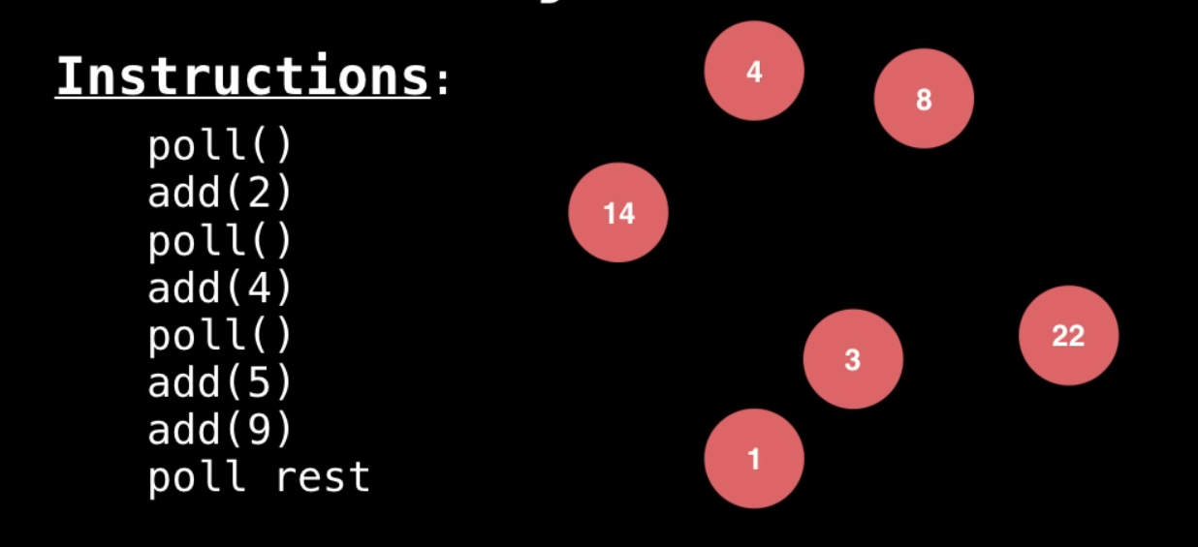
What is Priority Queues?

Slide 9
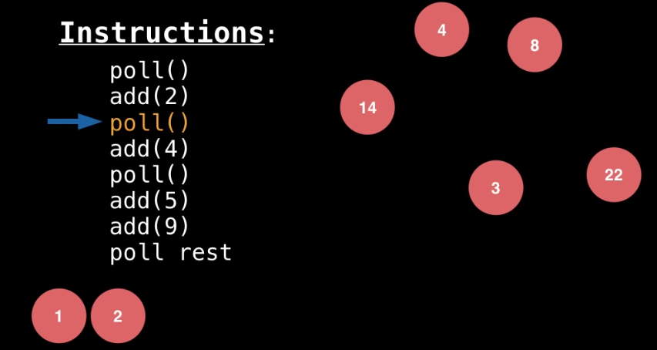
What is Priority Queues?

Slide 10
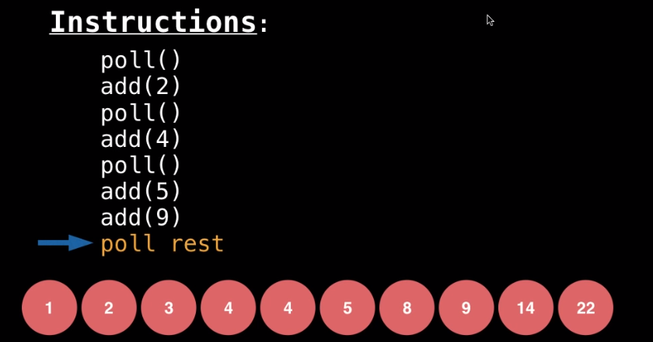

What is Priority Queues?

Slide 11
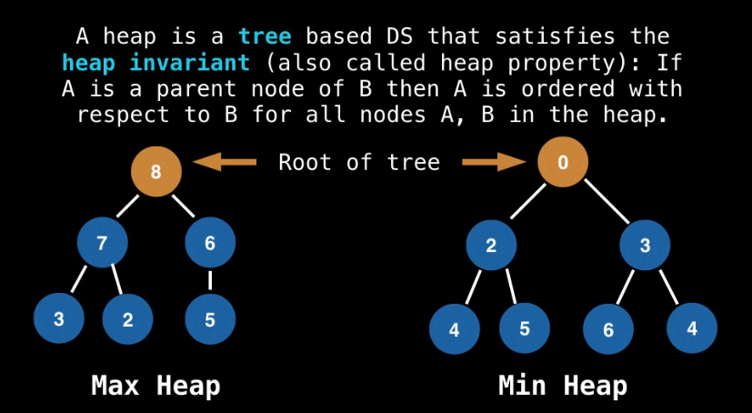
What is a Heap?

Slide 12
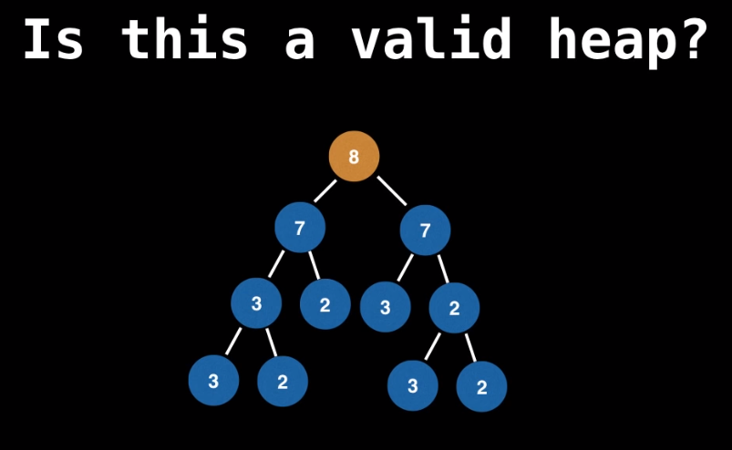
What is a Heap?

Slide 13
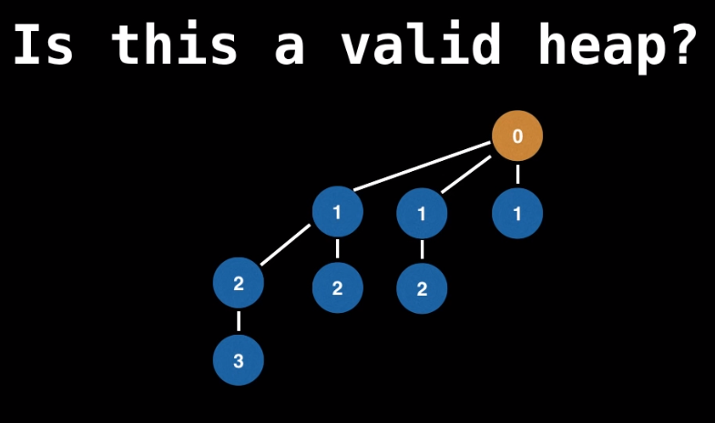
What is a Heap?

Slide 14
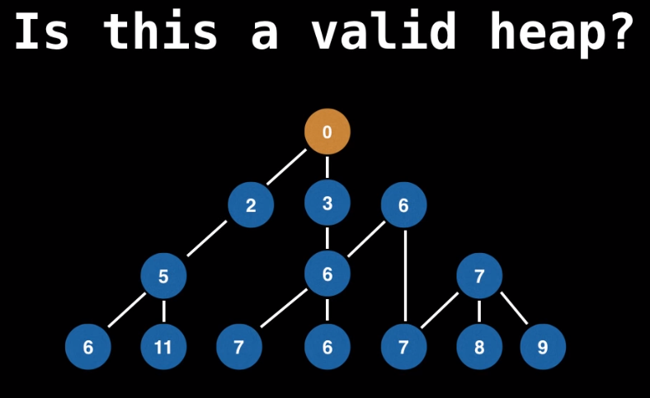
What is a Heap?

Slide 15
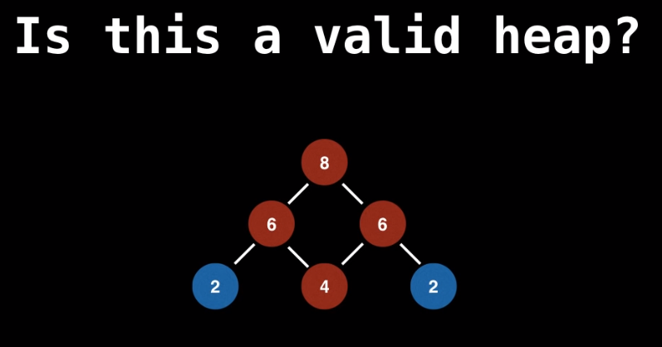
What is a Heap?

Slide 16
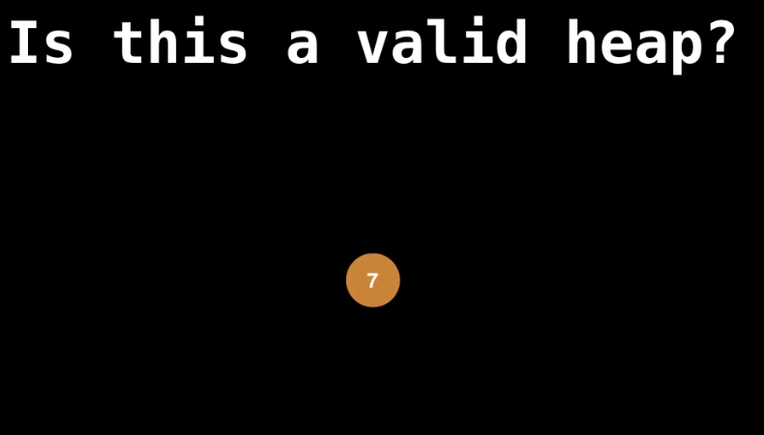
What is a Heap?

Slide 17
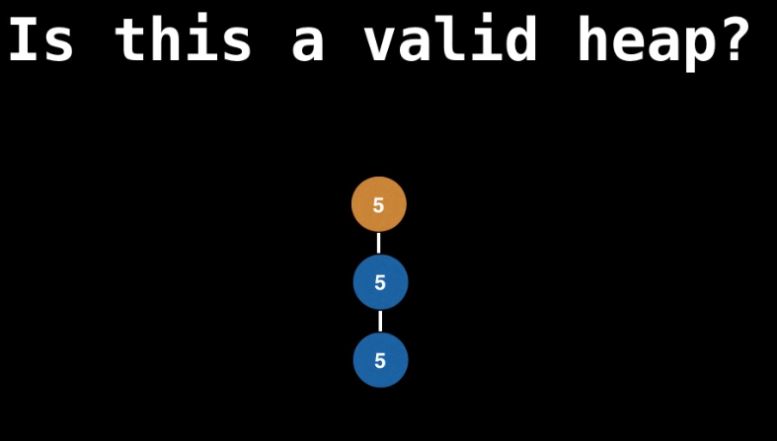
What is a Heap?

Slide 18
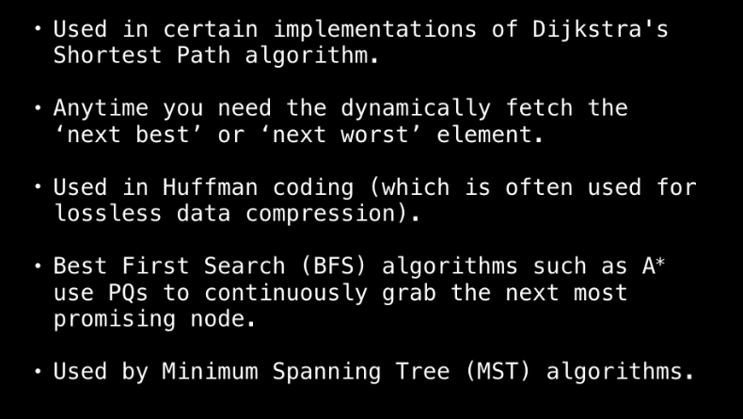
When and where is a PQ used?

Slide 19
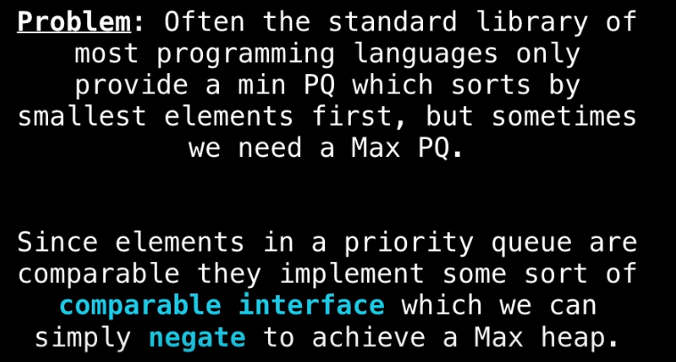
Turning Min PQ into Max PQ

Slide 20
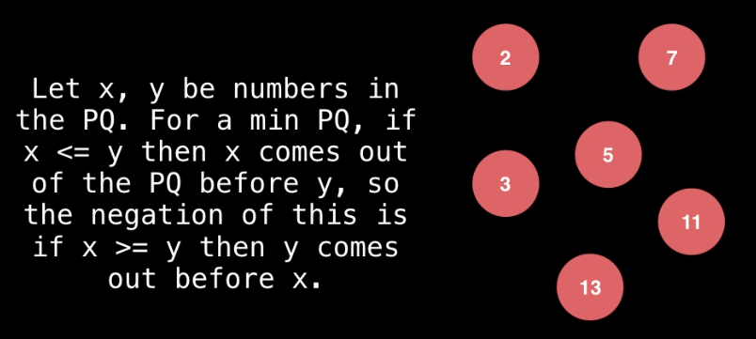
Turning Min PQ into Max PQ

Slide 21
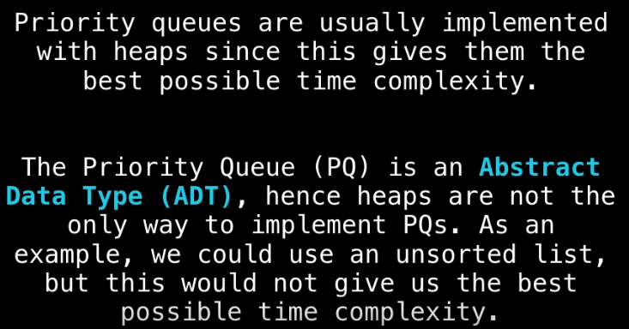
Ways of Implementing a PQ

Slide 22
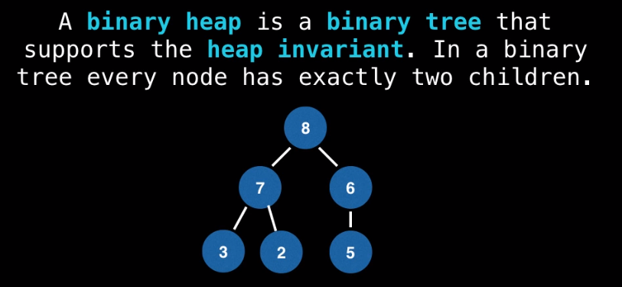
PQ with Binary Heap

Slide 23
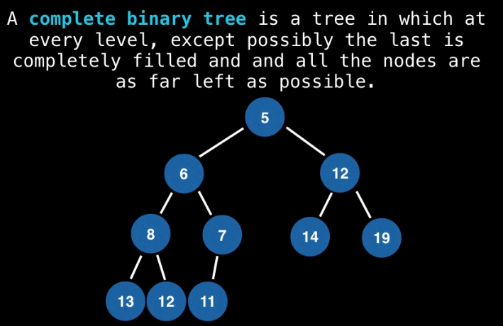
PQ with Binary Heap

Slide 24
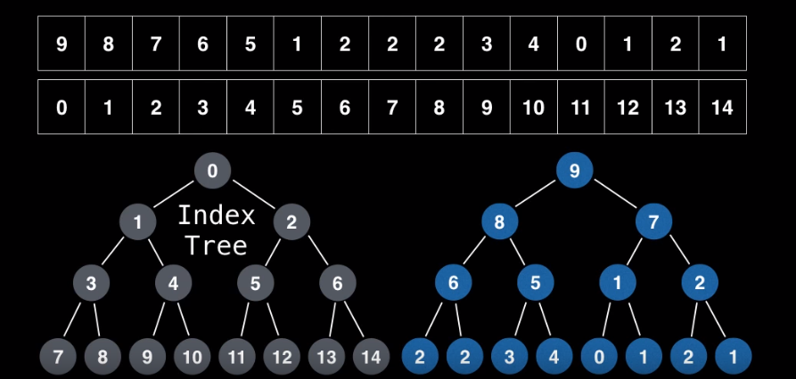
Binary Heap Representation

Slide 25
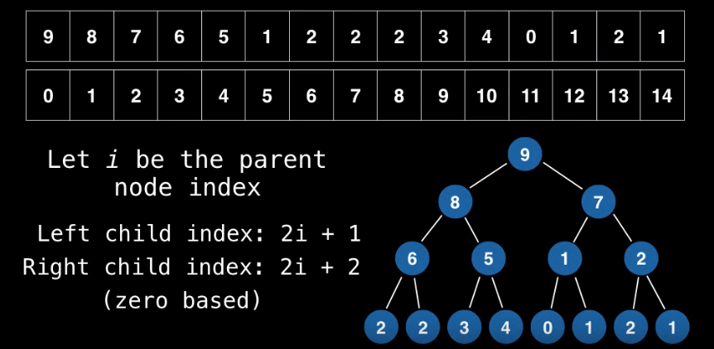
Binary Heap Representation

Slide 26
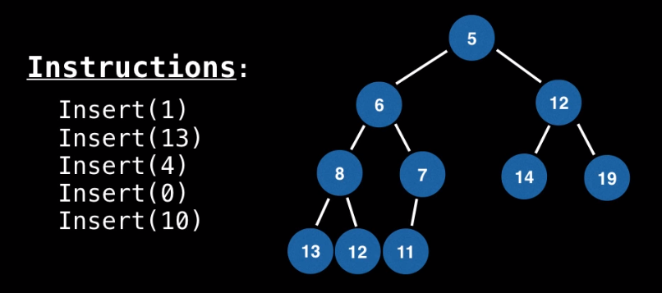
Adding Elements to a Binary Heap

Slide 27
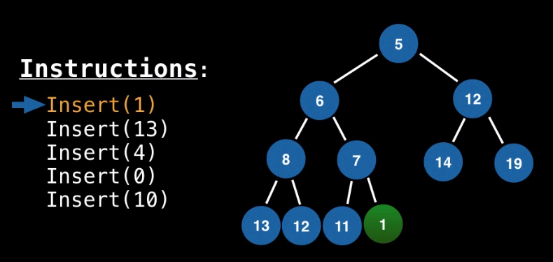
Adding Elements to a Binary Heap

Slide 28
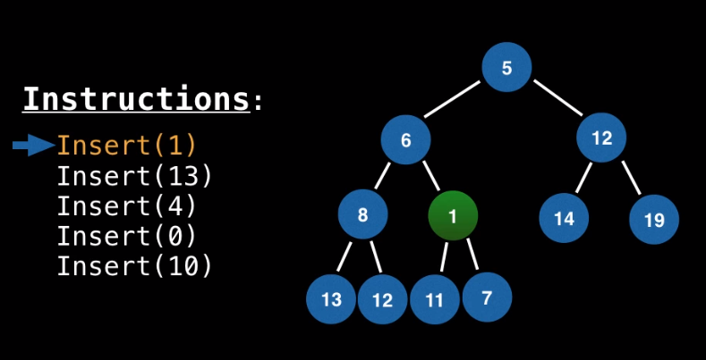
Adding Elements to a Binary Heap

Slide 29
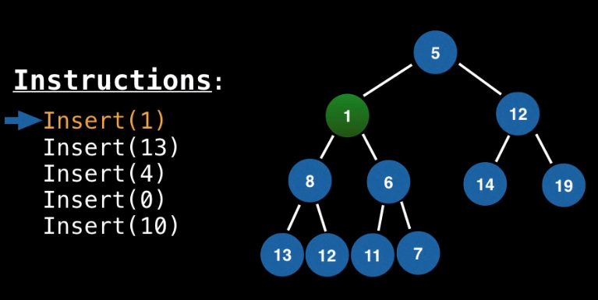
Adding Elements to a Binary Heap

Slide 30
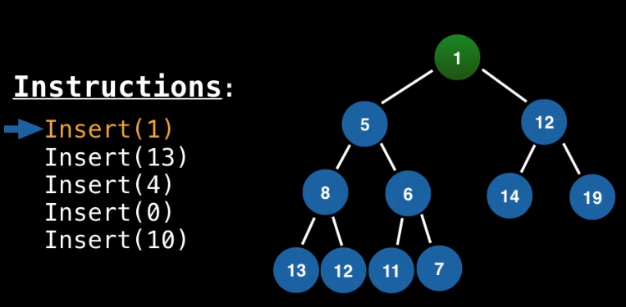
Adding Elements to a Binary Heap

Slide 31
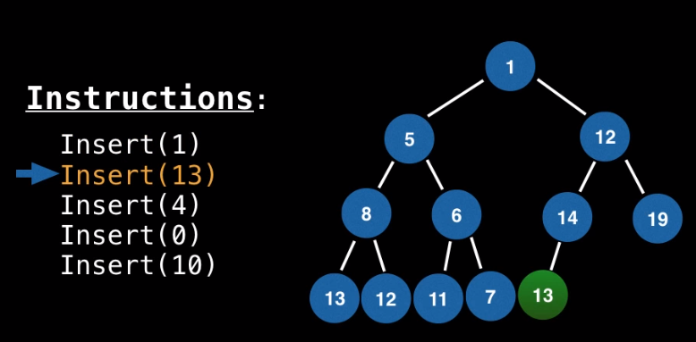
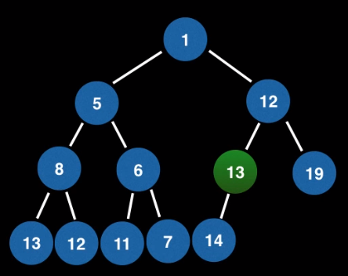
Adding Elements to a Binary Heap

Slide 32
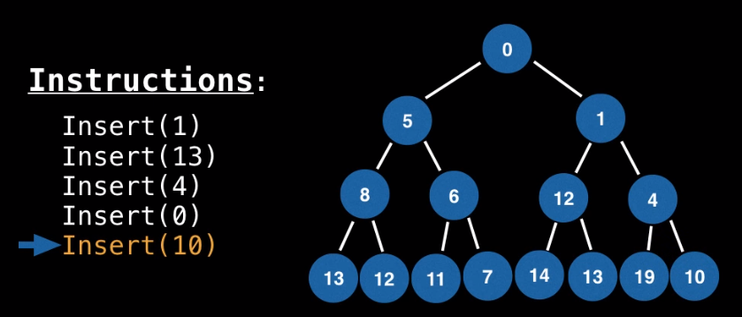
Adding Elements to a Binary Heap

Slide 33
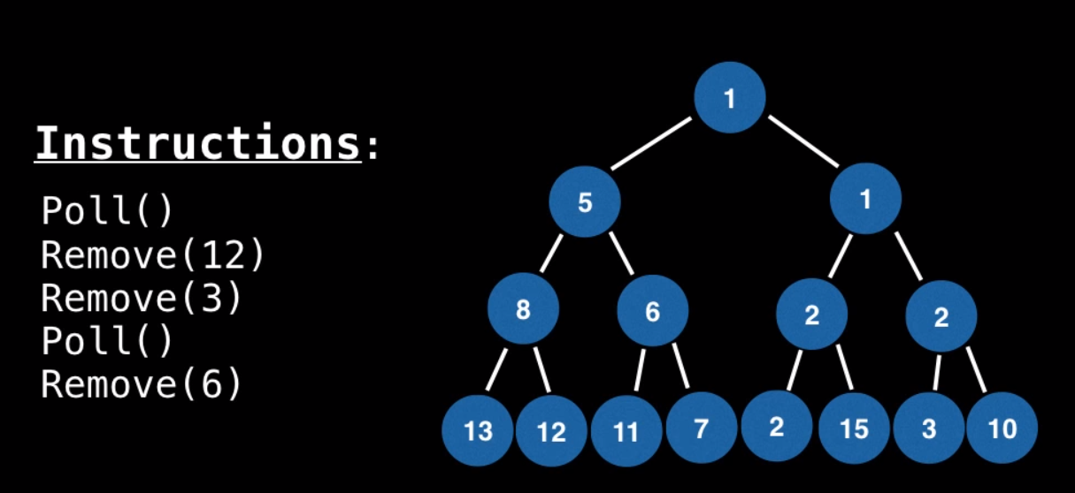
Remove Elements from a Binary Heap

Slide 34
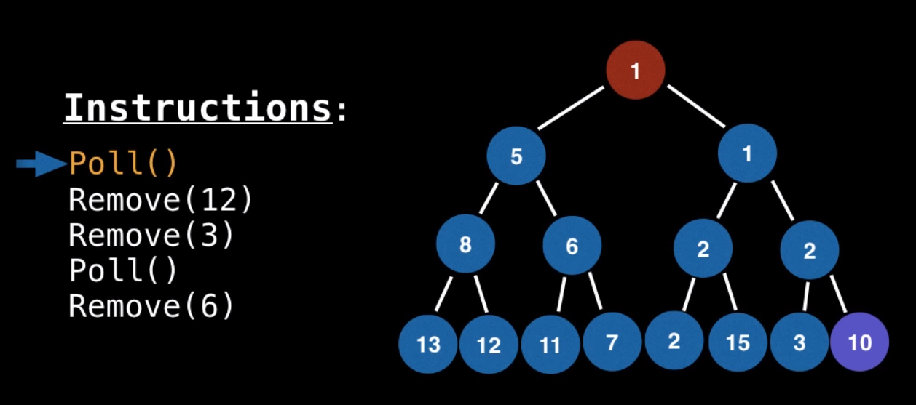
Remove Elements from a Binary Heap

Slide 35
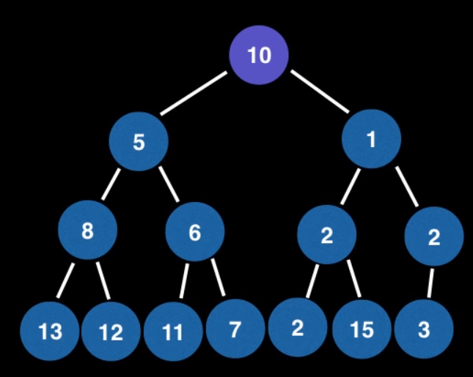
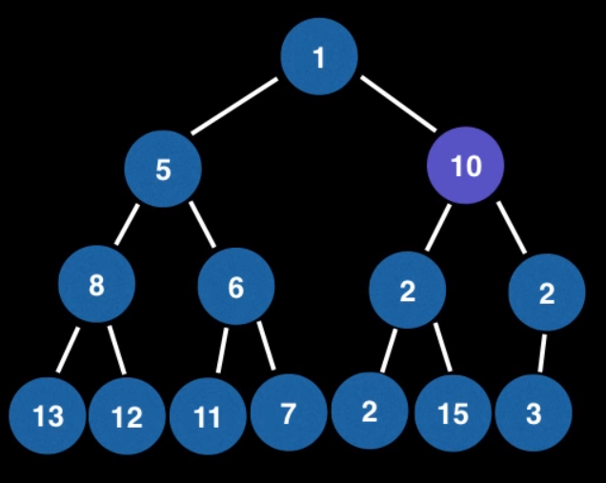
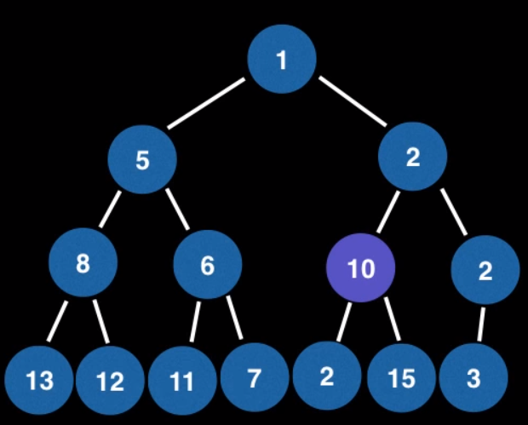
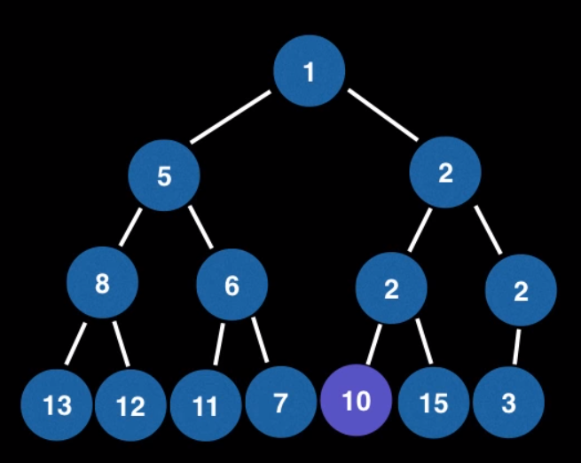
Remove Elements from a Binary Heap

Slide 36
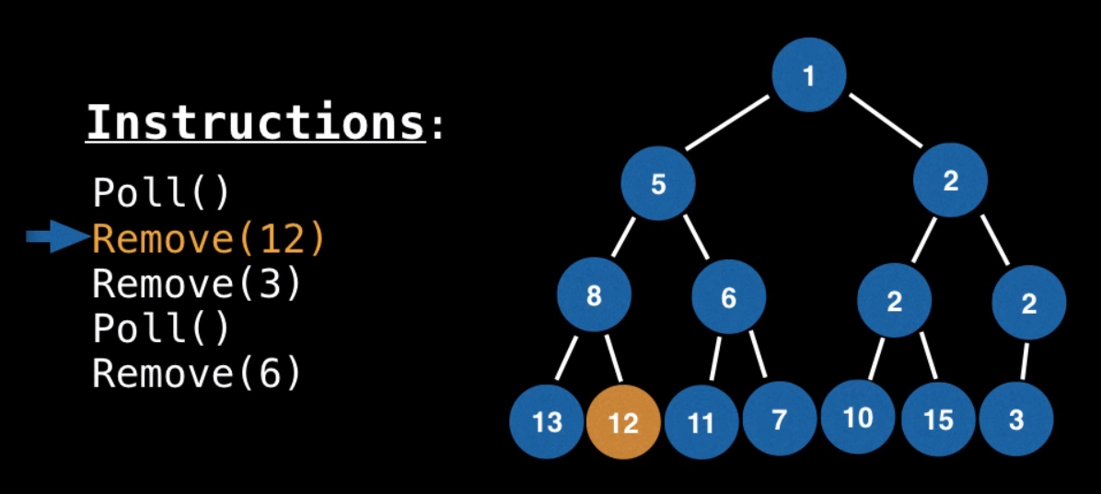
Remove Elements from a Binary Heap
Linear scan

Slide 37
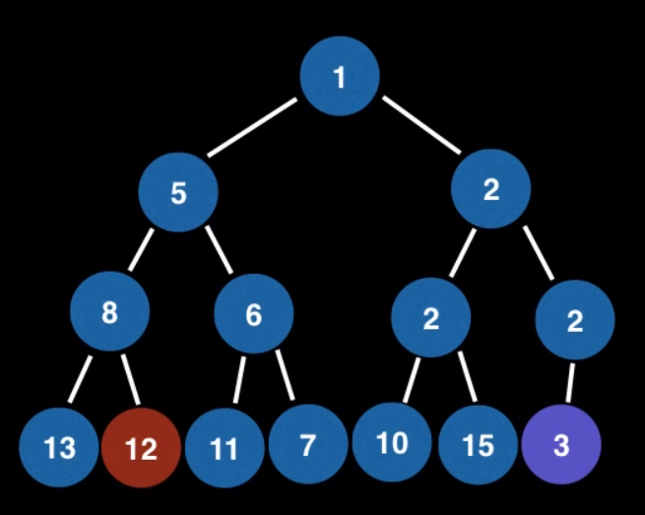
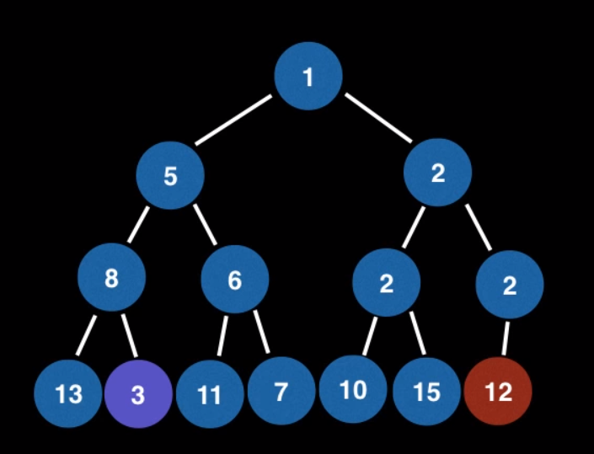
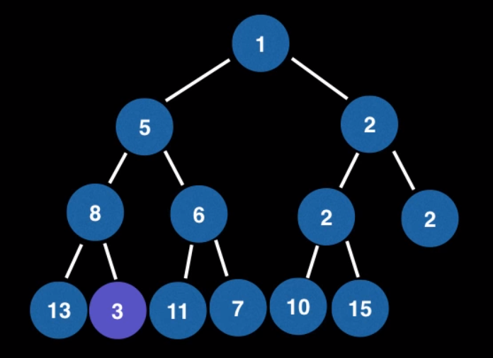
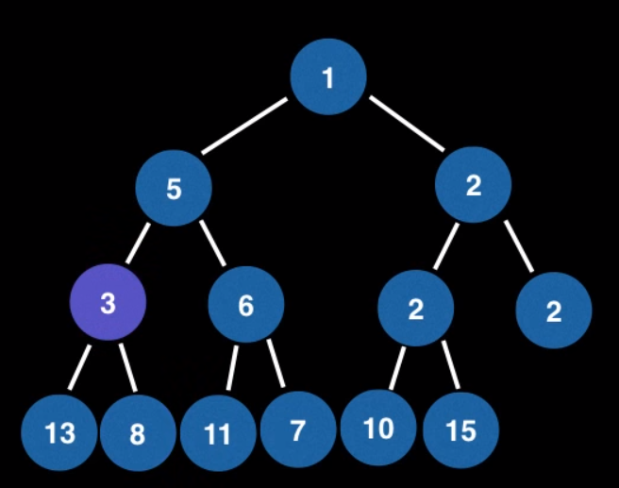
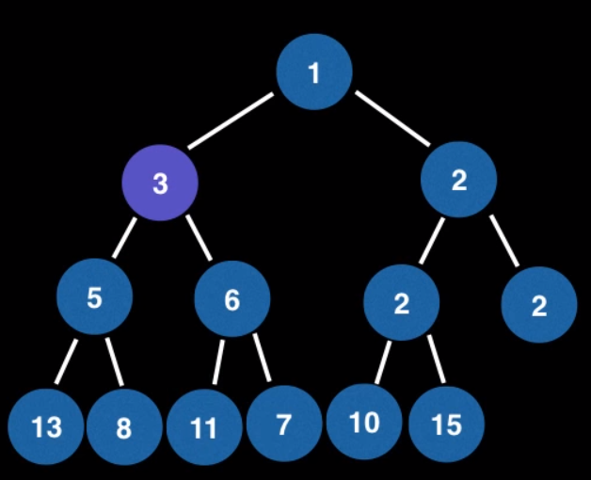
Remove Elements from a Binary Heap
Linear scan

Slide 38
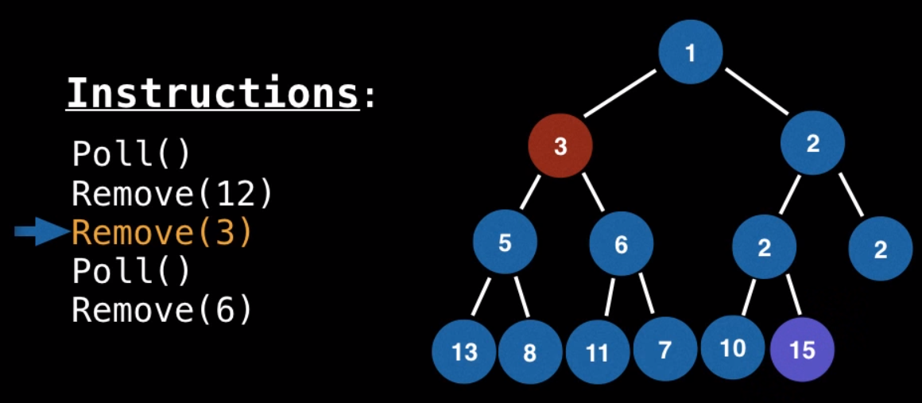
Remove Elements from a Binary Heap
Linear scan

Slide 39
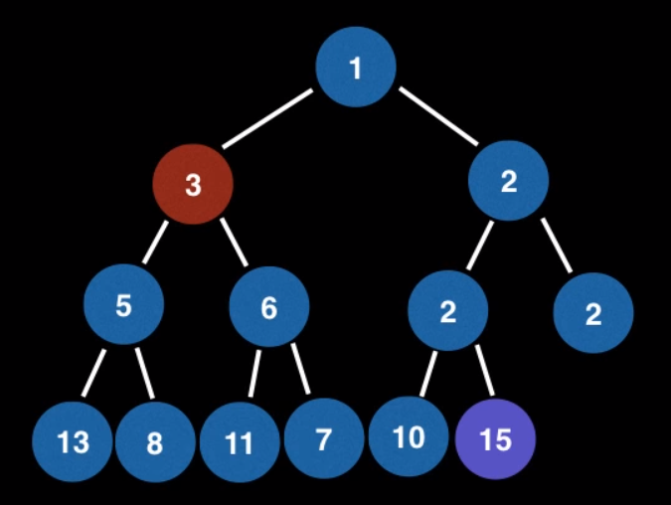
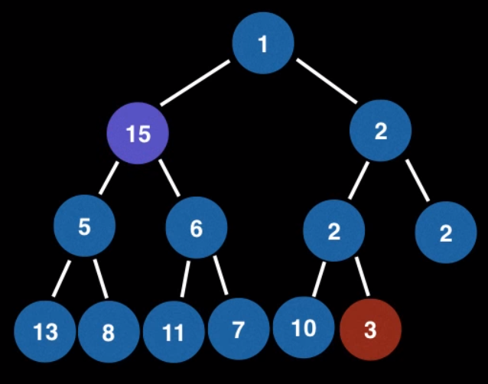
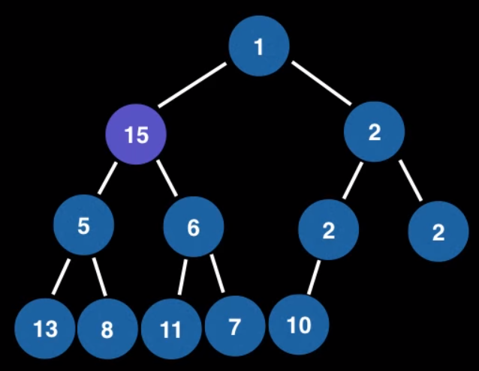
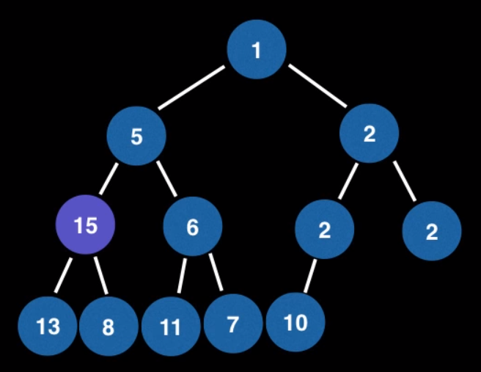
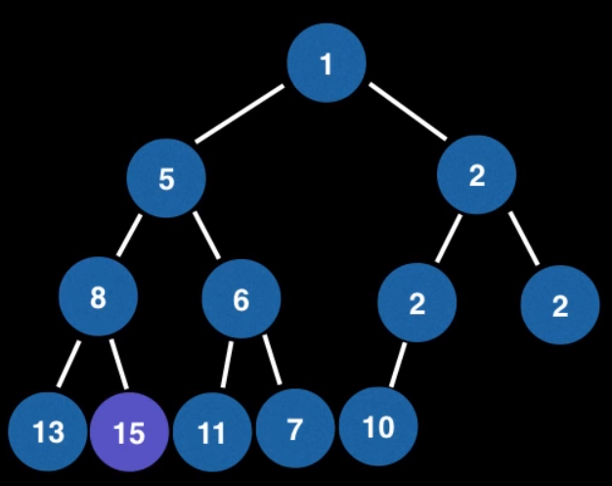
Remove Elements from a Binary Heap
Linear scan

Slide 40
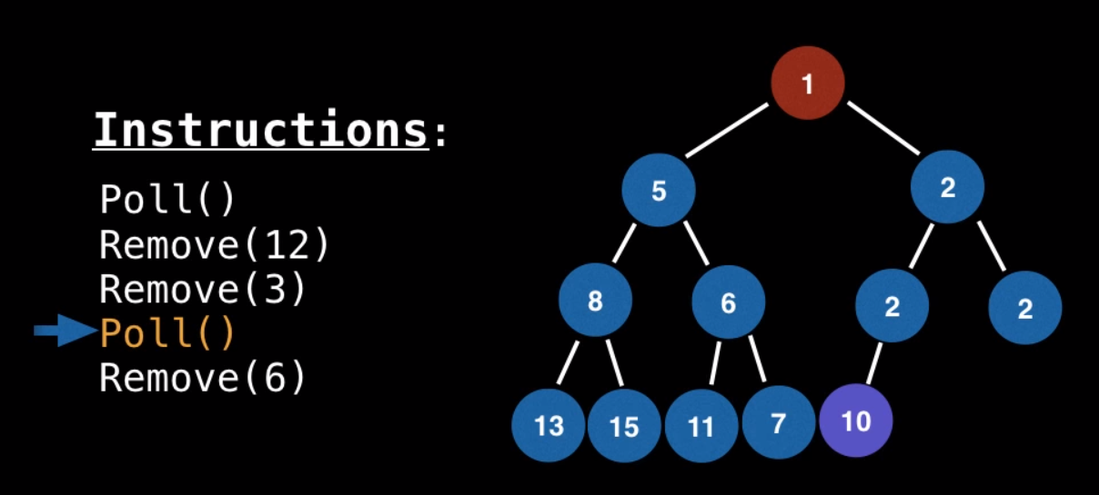
Remove Elements from a Binary Heap

Slide 41
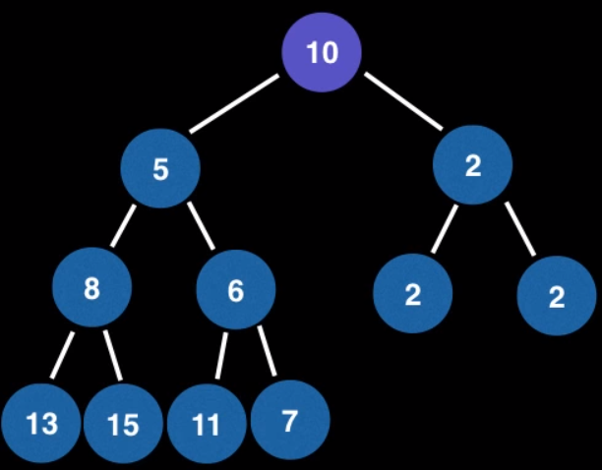
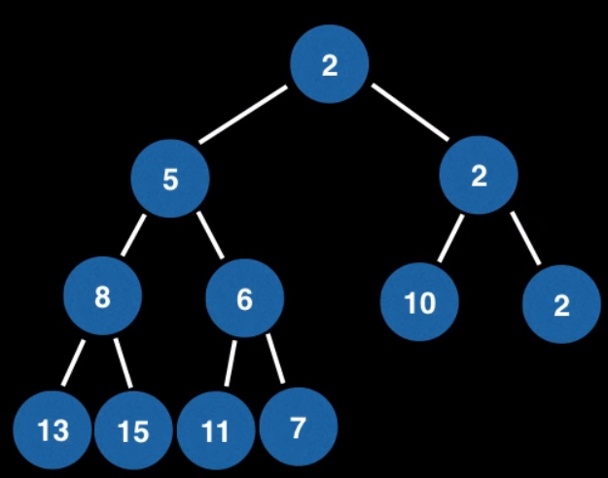
Remove Elements from a Binary Heap

Slide 42
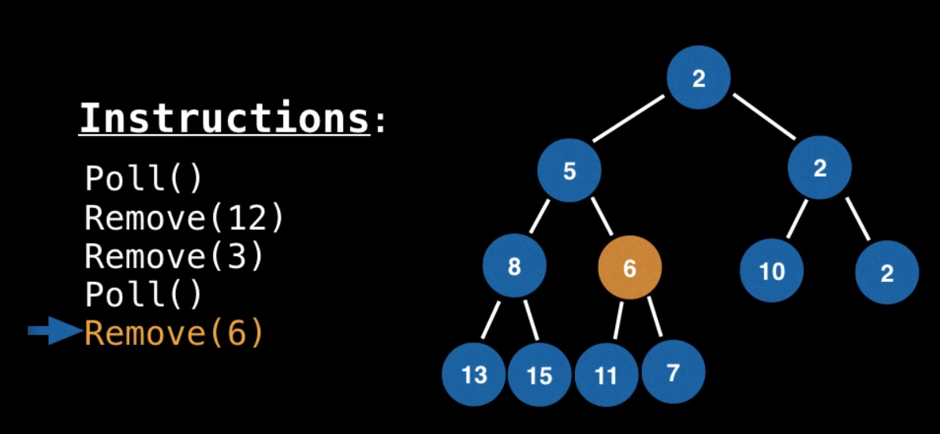
Remove Elements from a Binary Heap

Slide 43

Remove Elements from a Binary Heap

Slide 44

Movie Time!
https://www.youtube.com/watch?v=t0Cq6tVNRBA

Slide 45
Movie Time!
https://www.youtube.com/watch?v=1mm1I40cniQ

Slide 46

What We Need to Learn…. Hands on

Slide 47

What We Need to Learn…. Hands on

Slide 48

What We Need to Learn…. Hands on
https://www.geeksforgeeks.org/priority-queue-class-in-java-2/

Slide 49
What We Need to Learn…. Hands on
https://www.callicoder.com/java-priority-queue/

Slide 50
Priority Queues
Define priority queue ADT
Implement a priority queue with an unsorted and sorted lists
Explain Heap data structure
Implement a priority queue with a heap
Analyze heap-based priority queues
Sorting with a priority queue

Slide 51
Priority Queue ADT
FIFO principle used by queues does not suffice – priorities must come into play
A priority queue stores a collection of entries
Each entry is a pair (key, value)
Main methods of the Priority Queue ADT
insert(k, v) - inserts an entry with key k and value v
removeMin() - removes and returns the entry with smallest key, or null if the the priority queue is empty
Additional methods
min() - returns, but does not remove, an entry with smallest key, or null if the the priority queue is empty
size()
isEmpty()
Applications:
Standby flyers
Auctions
Stock market

Slide 52

Example
A sequence of priority queue methods:

Slide 53
Total Order Relations
Keys in a priority queue can be arbitrary objects on which an order is defined
Two distinct entries in a priority queue can have the same key
Mathematical concept of total order relation ≤
Comparability property: either x ≤ y or y ≤ x
Antisymmetric property: x ≤ y and y ≤ x ⇒ x = y
Transitive property: x ≤ y and y ≤ z ⇒ x ≤ z

Slide 54
Entry ADT
An entry in a priority queue is simply a key-value pair
Priority queues store entries to allow for efficient insertion and removal based on keys
Methods:
getKey: returns the key for this entry
getValue: returns the value associated with this entry
As a Java interface:
/**
* Interface for a key-value
* pair entry
**/
public interface Entry<K,V> {
K getKey();
V getValue();
}

Slide 55
Comparator ADT
A comparator encapsulates the action of comparing two objects according to a given total order relation
A generic priority queue uses an auxiliary comparator
The comparator is external to the keys being compared
When the priority queue needs to compare two keys, it uses its comparator
Primary method of the Comparator ADT
compare(x, y): returns an integer i such that
i < 0 if a < b,
i = 0 if a = b
i > 0 if a > b
An error occurs if a and b cannot be compared.

Slide 56
Example Comparator
As a concrete example, Code Fragment 9.3 defines a comparator that evaluates strings based on their length (rather than their natural lexicographic order):

Slide 57
The AbstractPriorityQueue Base Class
The base class provides four means of support:
a PQEntry class as a concrete implementation of the entry interface
an instance variable comp for a general Comparator and a protected method, compare(a, b), that makes use of the comparator.
a boolean checkKey method that verifies that a given key is appropriate for use with the comparator
an isEmpty implementation based upon the abstract size() method.

Slide 58
Sequence-based Priority Queue
Implementation with an unsorted list
Performance:
insert takes O(1) time since we can insert the item at the beginning or end of the sequence
removeMin and min take O(n) time since we have to traverse the entire sequence to find the smallest key
Implementation with a sorted list
Performance:
insert takes O(n) time since we have to find the place where to insert the item
removeMin and min take O(1) time, since the smallest key is at the beginning
4
5
2
3
1
1
2
3
4
5

Slide 59

Unsorted List Implementation

Slide 60

Unsorted List Implementation, 2

Slide 61

Sorted List Implementation

Slide 62

Sorted List Implementation, 2

Slide 63
Heaps
Presentation for use with the textbook Data Structures and Algorithms in Java, 6th edition, by M. T. Goodrich, R. Tamassia, and M. H. Goldwasser, Wiley, 2014
2
5
6
9
7

Slide 64
Recall Priority Queue ADT
A priority queue stores a collection of entries
Each entry is a pair (key, value)
Main methods of the Priority Queue ADT
insert(k, v) - inserts an entry with key k and value v
removeMin() - removes and returns the entry with smallest key
Additional methods
min() - returns, but does not remove, an entry with smallest key
size()
isEmpty()
Applications:
Standby flyers
Auctions
Stock market

Slide 65
Heaps
A heap is a binary tree storing keys at its nodes and satisfying the following properties:
Heap-Order: for every internal node v other than the root, key(v) ≥ key(parent(v))
Complete Binary Tree: let h be the height of the heap
for i = 0, … , h − 1, there are 2^{i} nodes of depth i
at depth h − 1, the internal nodes are to the left of the external nodes
The two nodes in level 2 are in the two leftmost possible positions at that level.
The last node of a heap is the rightmost node of maximum depth
2
5
6
9
7
last node

Slide 66
Height of a Heap
Theorem: A heap storing n keys has height O(log n)
Proof: (we apply the complete binary tree property)
Let h be the height of a heap storing n keys
Since there are 2^{i} keys at depth i = 0, … , h − 1 and at least one key at depth h, we have n ≥ 1 + 2 + 4 + … + 2^{h−1} + 1
Thus, n ≥ 2^{h} , i.e., h ≤ log n
depth
keys
0
1
1
2
h−1
2^{h−1}
h
1

Slide 67
Heaps and Priority Queues
We can use a heap to implement a priority queue
We store a (key, element) item at each internal node
We keep track of the position of the last node
(2, Sue)
(5, Pat)
(6, Mark)
(9, Jeff)
(7, Anna)

Slide 68
Insertion into a Heap
Method insertItem of the priority queue ADT corresponds to the insertion of a key k to the heap
The insertion algorithm consists of three steps
Find the insertion node z (the new last node)
Store k at z
Restore the heap-order property (discussed next)
2
5
z
6
9
7
insertion node
2
5
6
z
9
7
1

Slide 69
Upheap
After the insertion of a new key k, the heap-order property may be violated
Algorithm upheap restores the heap-order property by swapping k along an upward path from the insertion node
Upheap terminates when the key k reaches the root or a node whose parent has a key smaller than or equal to k
Since a heap has height O(log n), upheap runs in O(log n) time
2
1
5
1
5
2
z
z
9
7
6
9
7
6

Slide 70
Removal from a Heap
Method removeMin of the priority queue ADT corresponds to the removal of the root key from the heap
The removal algorithm consists of three steps
Replace the root key with the key of the last node w
Remove w
Restore the heap-order property (discussed next)
2
5
6
w
9
7
last node
7
5
w
6
9
new last node

Slide 71
Downheap
After replacing the root key with the key k of the last node, the heap-order property may be violated
Algorithm downheap restores the heap-order property by swapping key k along a downward path from the root
Downheap terminates when key k reaches a leaf or a node whose children have keys greater than or equal to k
Since a heap has height O(log n), downheap runs in O(log n) time
7
5
5
w
6
7
w
6
9
9

Slide 72
Updating the Last Node
The insertion node can be found by traversing a path of O(log n) nodes
Go up until a left child or the root is reached
If a left child is reached, go to the right child
Go down left until a leaf is reached
Similar algorithm for updating the last node after a removal

Slide 73
Array-based Heap Implementation
We can represent a heap with n keys by means of an array of length n
For the node at rank i
the left child is at rank 2i + 1
the right child is at rank 2i + 2
Links between nodes are not explicitly stored
Operation add corresponds to inserting at rank n + 1
Operation remove_min corresponds to removing at rank n
Yields in-place heap-sort
2
5
6
9
7
2
5
6
9
7
0
1
2
3
4

Slide 74

Java Implementation

Slide 75

Java Implementation, 2

Slide 76

Java Implementation, 3

Slide 77
Merging Two Heaps
We are given two two heaps and a key k
We create a new heap with the root node storing k and with the two heaps as subtrees
We perform downheap to restore the heap-order property
3
2
8
5
4
6
7
3
2
8
5
4
6
2
3
4
8
5
7
6

Slide 78
Bottom-up Heap Construction
We can construct a heap storing n given keys in using a bottom-up construction with log n phases
In phase i, pairs of heaps with 2^{i} −1 keys are merged into heaps with 2^{i+1}−1 keys (2^{i} −1 + 2^{i} −1 + 1)
2^{i} −1
2^{i} −1
2^{i+1}−1

Slide 79
Example
16
15
4
12
6
7
23
20
25
5
11
27
16
15
4
12
6
7
23
20

Slide 80
Example (contd.)
25
5
11
27
16
15
4
12
6
9
23
20
15
4
6
23
16
25
5
12
11
9
27
20

Slide 81
Example (contd.)
7
8
15
4
6
23
16
25
5
12
11
9
27
20
4
6
15
5
8
23
16
25
7
12
11
9
27
20

Slide 82
Example (end)
10
4
6
15
5
8
23
16
25
7
12
11
9
27
20
4
5
6
15
7
8
23
16
25
10
12
11
9
27
20

Slide 83
Analysis
We visualize the worst-case time of a downheap with a proxy path that goes first right and then repeatedly goes left until the bottom of the heap (this path may differ from the actual downheap path)
Since each node is traversed by at most two proxy paths, the total number of nodes of the proxy paths is O(n)
Thus, bottom-up heap construction runs in O(n) time
Bottom-up heap construction is faster than n successive insertions and speeds up the first phase of heap-sort

Slide 84
Priority Queue Sorting
We can use a priority queue to sort a list of comparable elements
Insert the elements one by one with a series of insert operations
Remove the elements in sorted order with a series of removeMin operations
The running time of this sorting method depends on the priority queue implementation
Algorithm PQ-Sort(S, C)
Input list S, comparator C for the elements of S
Output list S sorted in increasing order according to C
P ← priority queue with comparator C
while ¬S.isEmpty ()
e ← S.remove(S.first ())
P.insert (e, ∅)
while ¬P.isEmpty()
e ← P.removeMin().getKey()
S.addLast(e)

Slide 85
Selection-Sort
Selection-sort is the variation of PQ-sort where the priority queue is implemented with an unsorted sequence
Running time of Selection-sort:
Inserting the elements into the priority queue with n insert operations takes O(n) time
Removing the elements in sorted order from the priority queue with n removeMin operations takes time proportional to 1 + 2 + …+ n
Selection-sort runs in O(n²) time

Slide 86
Selection-Sort Example
Sequence S Priority Queue P
Input: (7,4,8,2,5,3,9) ()
Phase 1
(a) (4,8,2,5,3,9) (7)
(b) (8,2,5,3,9) (7,4)
.. .. ..
(g) () (7,4,8,2,5,3,9)
Phase 2
(a) (2) (7,4,8,5,3,9)
(b) (2,3) (7,4,8,5,9)
(c) (2,3,4) (7,8,5,9)
(d) (2,3,4,5) (7,8,9)
(e) (2,3,4,5,7) (8,9)
(f) (2,3,4,5,7,8) (9)
(g) (2,3,4,5,7,8,9) ()

Slide 87
Insertion-Sort
Insertion-sort is the variation of PQ-sort where the priority queue is implemented with a sorted sequence
Running time of Insertion-sort:
Inserting the elements into the priority queue with n insert operations takes time proportional to
1 + 2 + …+ n
Removing the elements in sorted order from the priority queue with a series of n removeMin operations takes O(n) time
Insertion-sort runs in O(n²) time

Slide 88
Insertion-Sort Example
Sequence S Priority queue P
Input: (7,4,8,2,5,3,9) ()
Phase 1
(a) (4,8,2,5,3,9) (7)
(b) (8,2,5,3,9) (4,7)
(c) (2,5,3,9) (4,7,8)
(d) (5,3,9) (2,4,7,8)
(e) (3,9) (2,4,5,7,8)
(f) (9) (2,3,4,5,7,8)
(g) () (2,3,4,5,7,8,9)
Phase 2
(a) (2) (3,4,5,7,8,9)
(b) (2,3) (4,5,7,8,9)
.. .. ..
(g) (2,3,4,5,7,8,9) ()

Slide 89
In-place Insertion-Sort
Instead of using an external data structure, we can implement selection-sort and insertion-sort in-place
A portion of the input sequence itself serves as the priority queue
For in-place insertion-sort
We keep sorted the initial portion of the sequence
We can use swaps instead of modifying the sequence
5
4
2
3
1
5
4
2
3
1
4
5
2
3
1
2
4
5
3
1
2
3
4
5
1
1
2
3
4
5
1
2
3
4
5

Slide 90

Recall PQ Sorting
We use a priority queue
Insert the elements with a series of insert operations
Remove the elements in sorted order with a series of removeMin operations
The running time depends on the priority queue implementation:
Unsorted sequence gives selection-sort: O(n²) time
Sorted sequence gives insertion-sort: O(n²) time
Can we do better?
Algorithm PQ-Sort(S, C)
Input sequence S, comparator C for the elements of S
Output sequence S sorted in increasing order according to C
P ← priority queue with comparator C
while ¬S.isEmpty ()
e ← S.remove (S. first ())
P.insert (e, e)
while ¬P.isEmpty()
e ← P.removeMin().getKey()
S.addLast(e)

Slide 91
Heap-Sort
Consider a priority queue with n items implemented by means of a heap
the space used is O(n)
methods insert and removeMin take O(log n) time
methods size, isEmpty, and min take time O(1) time
Using a heap-based priority queue, we can sort a sequence of n elements in O(n log n) time
The resulting algorithm is called heap-sort
Heap-sort is much faster than quadratic sorting algorithms, such as insertion-sort and selection-sort

